Slide 1
Detection and Identification of Pool Balls using Computer Vision
Simon Have & Jesper Bækdahl

Slide 2
Agenda
Introduction
Table Detection
Human Interaction Detection
Ball Detection
Ball Identification
Test and Conclusion

Slide 3
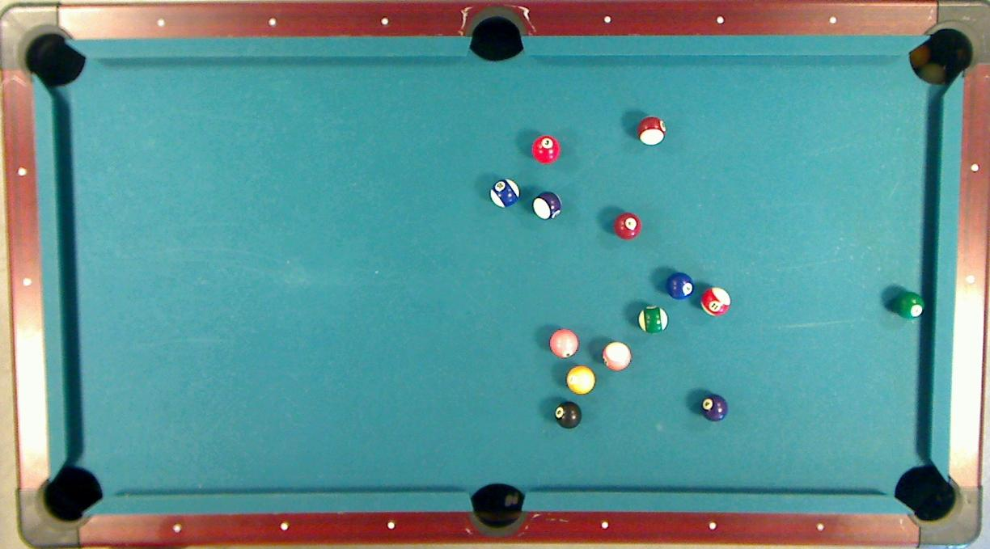

Slide 4
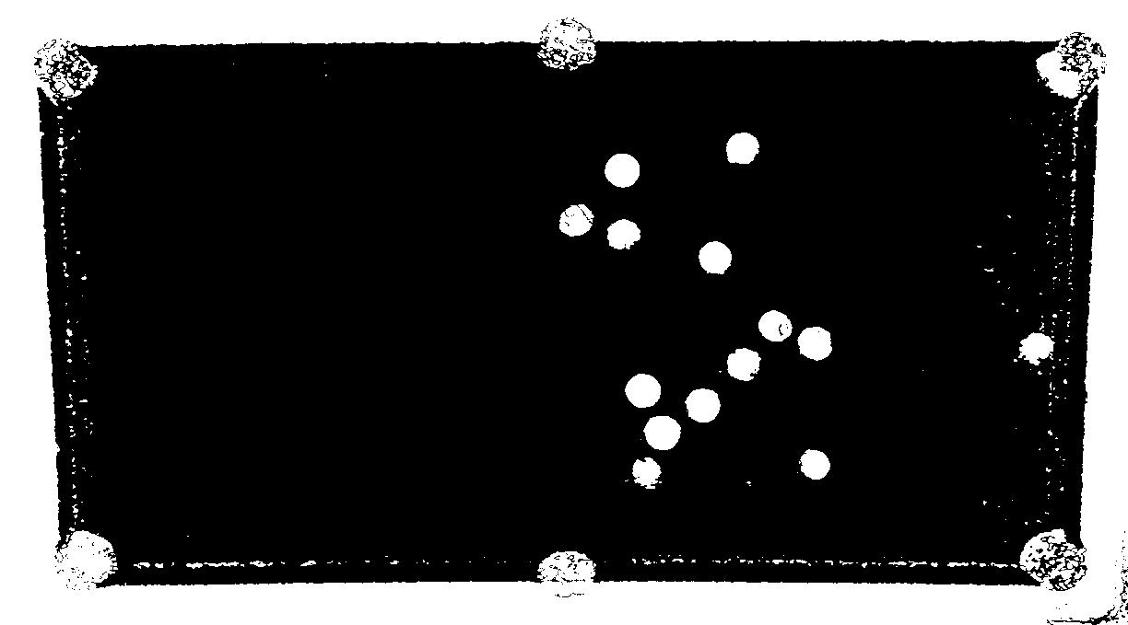
Ball Detection – Preliminary segmentation

Slide 5
Ball Detection – Probability Estimation
Discard background pixels
Determine primary color
Count primary colored pixels
Count white pixels

Slide 6
Ball Detection – Probability Estimation
24%
93%

Slide 7
Ball Detection – Best Candidates Selection
96%
98%

Slide 8
Ball Detection

Slide 9
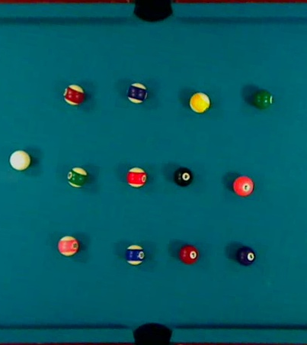
Ball Identification - Calibration
Select balls
Compute mean RGB
Determine white content in cue ball

Slide 10
Ball Identification – Color Comparison
Euclidean distance
Vector angle
Difficulties amongst similar colored balls
Light green
RGB = 178, 254, 178
D
A
Light brown
RGB = 236, 220, 154
Dark green
RGB = 148, 212, 148
C
B
Dark brown
RGB = 197, 183, 128
12°
RGB = 0, 0, 0

Slide 11
Ball Identification

Slide 12
Test
Table detection
Implicitly tested
Good results
Ball detection
Good results in all environments

Slide 13
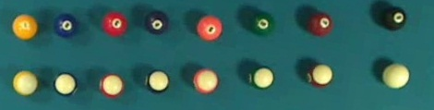
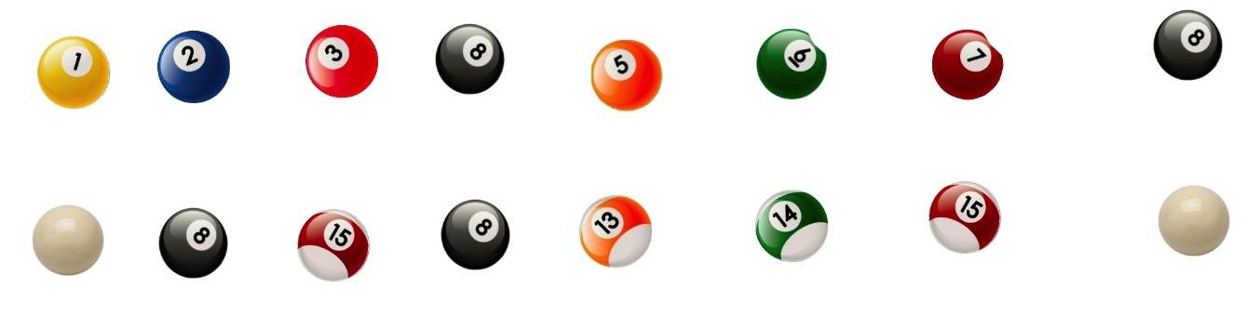
Test – Ball identification

Slide 14
Conclusion
Working prototype
Successful detection of table & balls
Problems with ball identification
Sensitive to color light changes
Camera problems
Unsolved bugs in software

